Slide 1
BUS ADMITTANCE MATRIX

Slide 2
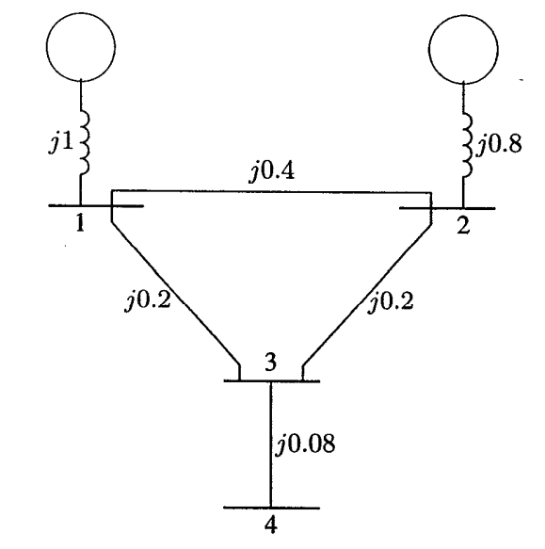
Q: In order to obtain the node-voltage equations, consider the simple power system shown in Figure 1, where impedances are expressed in per unit on a common MVA base and for simplicity resistances are neglected. Also draw the Bus Admittance Matrix
FIGURE 1: The impedance diagram of a simple system

Slide 3
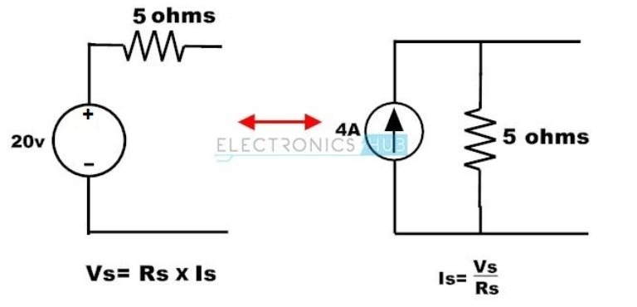
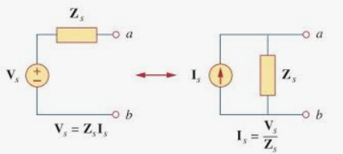
SOURCE CONVERSION

Slide 4
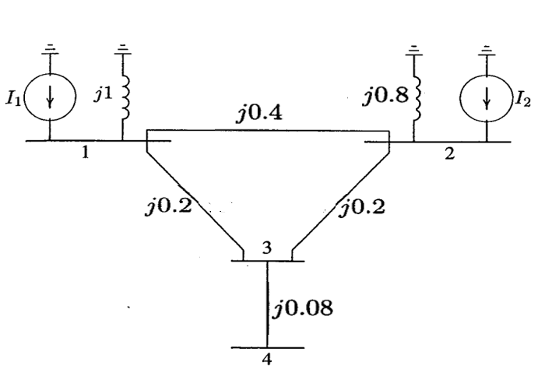
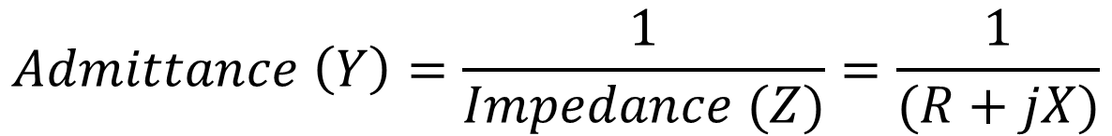
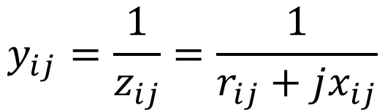
SOLUTION:
$$Admittance \left(Y\right)=\frac{1}{Impedance (Z)}=\frac{1}{(R+jX)}$$
$$y_{ij}=\frac{1}{z_{ij}}=\frac{1}{r_{ij}+jx_{ij}}$$
STEP-1: Convert Voltage Source into Current Source
FIGURE 1: The impedance diagram of a simple system

Slide 5
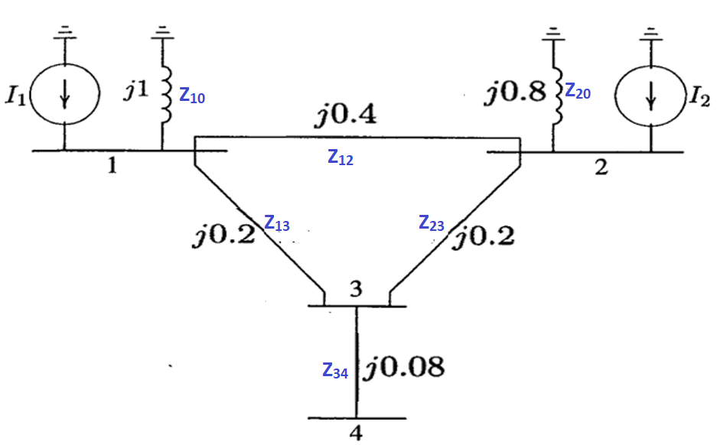
STEP-2: Assign the conventions (or naming) to each branch

Slide 6
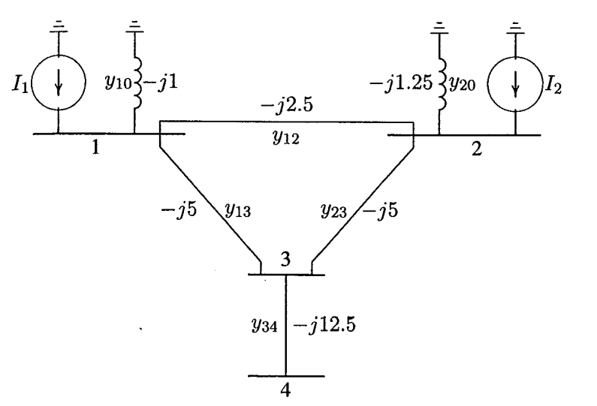
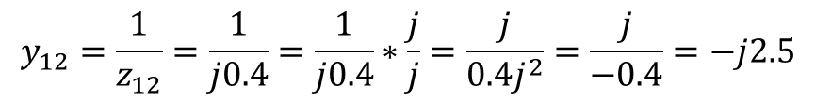

STEP-2: Convert Impedances values into Admittances Values
$$y_{10}=\frac{1}{z_{10}}=\frac{1}{j1}=\frac{1}{j1}∗\frac{j1}{j1}=\frac{j1}{j^{2}}=\frac{j1}{−1}=−j1$$
$$y_{12}=\frac{1}{z_{12}}=\frac{1}{j0.4}=\frac{1}{j0.4}∗\frac{j}{j}=\frac{j}{0.4j^{2}}=\frac{j}{−0.4}=−j2.5$$
FIGURE 2: The admittance diagram for system of Figure 1

Slide 7
FIGURE 2: The admittance diagram for system of Figure 1
The circuit has been redrawn in Figure 2 in terms of admittance and transformation to current sources. Node 0 (which is normally ground) is taken as reference. Applying KCL to the independent nodes 1 through 4 results in.

Slide 8
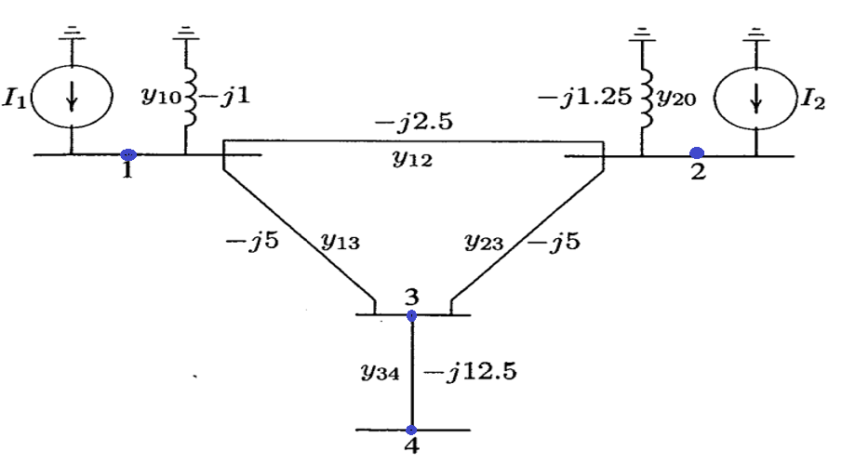





STEP-3: Apply KCL on each node
$$At Node 1$$
$$I_{1}= y_{10}V_{1}+y_{12}\left(V_{1}−V_{2}\right)+y_{13}(V_{1}−V_{3})$$
$$At Node 2$$
$$I_{2}= y_{20}V_{2}+y_{12}\left(V_{2}−V_{1}\right)+y_{23}(V_{2}−V_{3})$$
$$At Node 3$$
$$0= y_{23}(V_{3}−V_{2})+y_{13}\left(V_{3}−V_{1}\right)+y_{34}(V_{3}−V_{4})$$
FIGURE 2: The admittance diagram for system of Figure 1
$$At Node 4$$
$$0= y_{34}(V_{4}−V_{3})$$
Why both have difference values. Ans: It depends on at Node. If At node 1 than y12 means (y1-y2). If At node 2 than y12 means (y2-y1)

Slide 9
STEP-4: Re-arranging these equations
$$I_{1}= y_{10}V_{1}+y_{12}\left(V_{1}−V_{2}\right)+y_{13}(V_{1}−V_{3})= y_{10}V_{1}+y_{12}V_{1}−{y_{12}V}_{2}+y_{13}V_{1}−{y_{13}V}_{3}$$
$$I_{1}= {(y}_{10}+y_{12}+y_{13})V_{1}−{y_{12}V}_{2}−{y_{13}V}_{3} (A)$$
$I_{2}= y_{20}V_{2}+y_{12}\left(V_{2}−V_{1}\right)+y_{23}\left(V_{2}−V_{3}\right)=y_{20}V_{2}+y_{12}$ $V_{2} −y_{12} V_{1}+y_{23}$ $V_{2}−y_{23} V_{3}$
$I_{2}=−y_{12} V_{1}+(y_{20}+y_{12}+y_{23})V_{2}−y_{23} V_{3}$ (B)
$0= y_{23}(V_{3}−V_{2})+y_{13}\left(V_{3}−V_{1}\right)+y_{34}(V_{3}−V_{4})$ $= y_{23}V_{3}−y_{23}V_{2}+y_{13}V_{3}−y_{13}V_{1}+y_{34}V_{3}−y_{34}V_{4}$
$$0=−y_{13}V_{1}−y_{23}V_{2}+\left(y_{13}+y_{23}+y_{34}\right)V_{3}−y_{34}V_{4} (C)$$
$0= y_{34}(V_{4}−V_{3})$ $= y_{34}V_{4}−y_{34}V_{3}$
$$0=−y_{34}V_{3}+ y_{34}V_{4} (D)$$

Slide 10












STEP-5: Write General Admittance Equations of 4 Bus System
$$Y_{11}={(y}_{10}+y_{12}+y_{13})$$
$$I_{1}=Y_{11}V_{1}+{Y_{12}V}_{2}+{Y_{13}V}_{3}+{Y_{14}V}_{4}$$
$Y_{12}=$- $y_{12}$
$$I_{2}=Y_{21}V_{1}+{Y_{22}V}_{2}+{Y_{23}V}_{3}+{Y_{24}V}_{4}$$
$Y_{13}=$- $y_{13}$
$$I_{3}=Y_{31}V_{1}+{Y_{32}V}_{2}+{Y_{33}V}_{3}+{Y_{34}V}_{4}$$
$$Y_{21}=\text{- }y_{12}$$
$$I_{4}=Y_{41}V_{1}+{Y_{42}V}_{2}+{Y_{43}V}_{3}+{Y_{44}V}_{4}$$
$$Y_{22}=(y_{20}+y_{12}+y_{23})$$
Compare above equations with equation (A), (B), (C ) and 9D)
$Y_{23}=$- $y_{23}$
$$Y_{33}= y_{13}+y_{23}+y_{34}$$
$$I_{1}= {(y}_{10}+y_{12}+y_{13})V_{1}−{y_{12}V}_{2}−{y_{13}V}_{3} (A)$$
$$Y_{44}= y_{34}$$
$I_{2}=−y_{12} V_{1}+(y_{20}+y_{12}+y_{23})V_{2}−y_{23} V_{3}$ (B)
$Y_{31}=$- $y_{13}$
$Y_{32}=$- $y_{23}$
$$0=−y_{13}V_{1}−y_{23}V_{2}+\left(y_{13}+y_{23}+y_{34}\right)V_{3}−y_{34}V_{4} (C)$$
$Y_{34}=$- $y_{34}$
$$0=−y_{34}V_{3}+ y_{34}V_{4} (D)$$
$Y_{43}=$- $y_{34}$

Slide 11
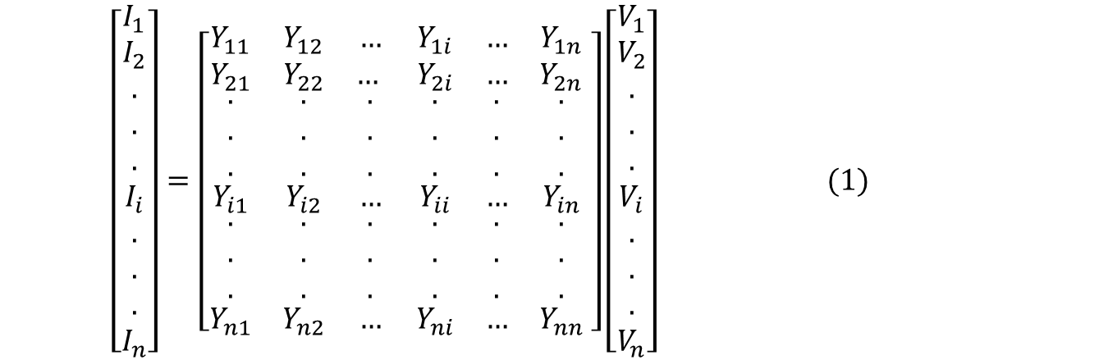
STEP-6: Write N-times General Admittance Equations of N Bus System
$$I_{1}=Y_{11}V_{1}+{Y_{12}V}_{2}+{Y_{13}V}_{3}+{Y_{14}V}_{4}$$
$$I_{2}=Y_{21}V_{1}+{Y_{22}V}_{2}+{Y_{23}V}_{3}+{Y_{24}V}_{4}$$
$$I_{3}=Y_{31}V_{1}+{Y_{32}V}_{2}+{Y_{33}V}_{3}+{Y_{34}V}_{4}$$
$$I_{4}=Y_{41}V_{1}+{Y_{42}V}_{2}+{Y_{43}V}_{3}+{Y_{44}V}_{4}$$
Convert it into Matrix Form
$$\left[\begin{aligned}I_{1} \\ I_{2} \\ . \\ . \\ . \\ I_{i} \\ . \\ . \\ . \\ I_{n}\end{aligned}\right]=\left[\begin{matrix}Y_{11} & Y_{12} & … & Y_{1i} & … & Y_{1n} \\ Y_{21} & Y_{22} & … & Y_{2i} & … & Y_{2n} \\ \begin{aligned}. \\ . \\ .\end{aligned} & \begin{aligned}. \\ . \\ .\end{aligned} & \begin{aligned}. \\ . \\ .\end{aligned} & \begin{aligned}. \\ . \\ .\end{aligned} & \begin{aligned}. \\ . \\ .\end{aligned} & \begin{aligned}. \\ . \\ .\end{aligned} \\ Y_{i1} & Y_{i2} & … & Y_{ii} & … & Y_{in} \\ \begin{aligned}. \\ . \\ .\end{aligned} & \begin{aligned}. \\ . \\ .\end{aligned} & \begin{aligned}. \\ . \\ .\end{aligned} & \begin{aligned}. \\ . \\ .\end{aligned} & \begin{aligned}. \\ . \\ .\end{aligned} & \begin{aligned}. \\ . \\ .\end{aligned} \\ Y_{n1} & Y_{n2} & … & Y_{ni} & … & Y_{nn}\end{matrix} \right]\left[\begin{aligned}V_{1} \\ V_{2} \\ . \\ . \\ . \\ V_{i} \\ . \\ . \\ . \\ V_{n}\end{aligned}\right] (1)\begin{matrix} & & & \\ & & & \\ & & & \\ & & & \end{matrix}$$
$I_{bus}=Y_{bus}V_{bus}$ (2)

Slide 12
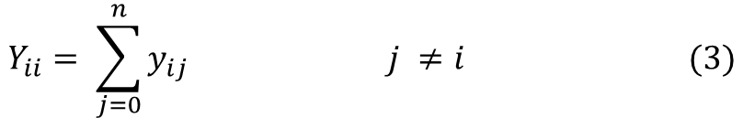

where I_{bus} is the vector of the injected bus currents (i.e., external current sources). The current is positive when flowing towards the bus, and it is negative if flowing away from the bus. V_{bus} is the vector of bus voltages measured from the reference node (i.e., node voltages). Y_{bus} is known as the bus admittance matrix. The diagonal element of each node is the sum of admittances connected to. It is also known as self-admittance or driving point admittance, i.e.,
$$Y_{ii}= \sum_{j=0}^{n}{y_{ij} j ≠i (3)}$$
The off-diagonal element is equal to the negative of the admittance between nodes. It is also known as the mutual admittance or transfer admittance, i.e.,
$$Y_{ij}=Y_{ji}= −y_{ij} (4)$$
When the bus currents are known, than equation (2) can be solved for the n bus voltages.
$I_{bus}=Y_{bus}V_{bus}$ (2)
$$V_{bus}=Y_{bus}^{−1}I_{bus} (5)$$

Slide 13
The inverse of the bus admittance matrix is known as the bus impedance matrix Z_{bus} . The admittance matrix obtained with one of the buses as reference is nonsingular. Otherwise, the nodal matrix is singular.
Inspection of the bus admittance matrix reveals that the matrix is symmetric along the leading diagonal, and we need to store the upper triangular nodal admittance matrix only.
In a typical power system network, each bus is connected to only a few nearby buses. Consequently, many off-diagonal elements are zero. Such a matrix is called sparse, and efficient numerical techniques can be applied to compute its inverse. By means of an appropriately ordered triangular decomposition, the inverse of a sparse matrix can be expressed as a product of sparse matrix factors, thereby giving an advantage in computational speed, storage and reduction of round-off errors. However, Z_{bus} , which is required for short-circuit analysis, can be obtained directly by the method of building algorithm without the need for matrix inversion. This technique discussed in next chapters.

Slide 14






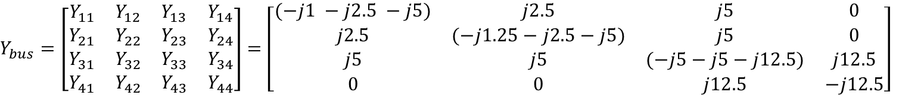



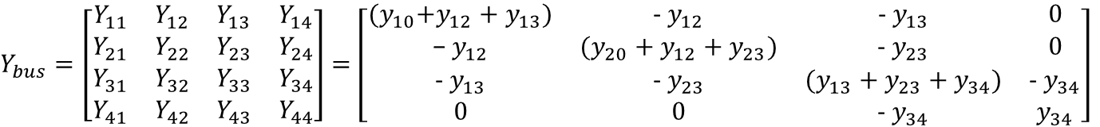



Now calculate the Bus Admittance matrix
$$Y_{11}={(y}_{10}+y_{12}+y_{13})$$
$Y_{12}=$- $y_{12}$
$Y_{13}=$- $y_{13}$
$$Y_{21}=\text{- }y_{12}$$
$$Y_{22}=(y_{20}+y_{12}+y_{23})$$
$Y_{23}=$- $y_{23}$
$$Y_{33}= y_{13}+y_{23}+y_{34}$$
$Y_{bus}=\left[\begin{matrix}Y_{11} & Y_{12} & Y_{13} & Y_{14} \\ Y_{21} & Y_{22} & Y_{23} & Y_{24} \\ Y_{31} & Y_{32} & Y_{33} & Y_{34} \\ Y_{41} & Y_{42} & Y_{43} & Y_{44}\end{matrix}\right]$ $=\left[\begin{matrix}{(y}_{10}+y_{12}+y_{13}) & \text{- }y_{12} & \text{- }y_{13} & 0 \\ \text{− }y_{12} & (y_{20}+y_{12}+y_{23}) & \text{- }y_{23} & 0 \\ \text{- }y_{13} & \text{- }y_{23} & (y_{13}+y_{23}+y_{34}) & \text{- }y_{34} \\ 0 & 0 & \text{- }y_{34} & y_{34}\end{matrix}\right]$
$$Y_{44}= y_{34}$$
$Y_{31}=$- $y_{13}$
$Y_{32}=$- $y_{23}$
$Y_{34}=$- $y_{34}$
$Y_{bus}=\left[\begin{matrix}Y_{11} & Y_{12} & Y_{13} & Y_{14} \\ Y_{21} & Y_{22} & Y_{23} & Y_{24} \\ Y_{31} & Y_{32} & Y_{33} & Y_{34} \\ Y_{41} & Y_{42} & Y_{43} & Y_{44}\end{matrix}\right]$ $=\left[\begin{matrix}(−j1 −j2.5 −j5) & j2.5 & j5 & 0 \\ j2.5 & (−j1.25−j2.5−j5) & j5 & 0 \\ j5 & j5 & (−j5−j5−j12.5) & j12.5 \\ 0 & 0 & j12.5 & −j12.5\end{matrix}\right]$
$Y_{43}=$- $y_{34}$

Slide 15
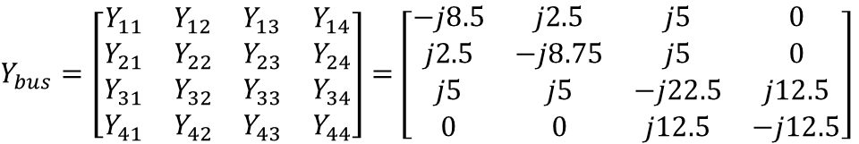
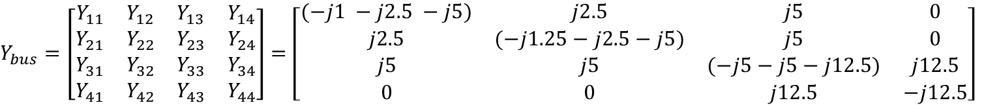
$Y_{bus}=\left[\begin{matrix}Y_{11} & Y_{12} & Y_{13} & Y_{14} \\ Y_{21} & Y_{22} & Y_{23} & Y_{24} \\ Y_{31} & Y_{32} & Y_{33} & Y_{34} \\ Y_{41} & Y_{42} & Y_{43} & Y_{44}\end{matrix}\right]$ $=\left[\begin{matrix}(−j1 −j2.5 −j5) & j2.5 & j5 & 0 \\ j2.5 & (−j1.25−j2.5−j5) & j5 & 0 \\ j5 & j5 & (−j5−j5−j12.5) & j12.5 \\ 0 & 0 & j12.5 & −j12.5\end{matrix}\right]$
$Y_{bus}=\left[\begin{matrix}Y_{11} & Y_{12} & Y_{13} & Y_{14} \\ Y_{21} & Y_{22} & Y_{23} & Y_{24} \\ Y_{31} & Y_{32} & Y_{33} & Y_{34} \\ Y_{41} & Y_{42} & Y_{43} & Y_{44}\end{matrix}\right]$ $=\left[\begin{matrix}−j8.5 & j2.5 & j5 & 0 \\ j2.5 & −j8.75 & j5 & 0 \\ j5 & j5 & −j22.5 & j12.5 \\ 0 & 0 & j12.5 & −j12.5\end{matrix}\right]$

